Slide 1
Data Traffic(Network Traffic):
Network traffic also called data traffic, Data Traffic or Network traffic is referred as the amount of data moving across a computer network at any given time.
The Data is broken down into data packets and sent over a network before being reassembled by the receiving device or computer.
Data Traffic affects network quality because an unusually high amount of traffic can mean slow download speeds or spotty Voice over Internet Protocol (VoIP) connections.
Data traffic has two directional flows: 1.North-south data Traffic flow2.East-west Data Traffic flow.
1.North-south Data Traffic flow:
North-south traffic refers to client-to-server traffic that moves between the data center and the rest of the network (i.e., a location outside of the data center).
2.East-west Data Traffic flow:
East-west traffic refers to traffic within a data center, also known as server-to-server traffic(i.e. location with in a Data center).

Slide 2
Types of Data Traffic or Network Traffic:
There are two main types of network traffic: 1.Unicast Data Traffic 2.Multicast Data Traffic.
1.Unicast Data Traffic:
Unicast Data Traffic is sent from one computer to another specific computer. This is the most common type of traffic on the Internet and includes things like web browsing, email, and file transfers.
2.Multicast Data Traffic:
Multicast Data Traffic is sent from one computer to a group of computers. This is often used for streaming media, such as audio or video.

Slide 3
Congestion:
An important issue in the Internet is congestion. Congestion in a network may occur if the load on the network that the number of packets sent to the network is greater than the capacity of the network that the number of packets a network can handle.
Congestion occurs when the data traffic flowing through a network exceeds its maximum capacity. Typically, due to data traffic overloading when a link or network node is handling data in excess of its capacity.
In most cases, congestion is a temporary issue with the network caused due to a sudden upsurge of Data traffic, however, sometimes, a network is continually congested, indicating some network problems.
Congestion in a network or internet occurs because routers and switches have queues and buffers that hold the packets before and after processing.
congestion refers to a reduction in quality of service (QOS) that causes packet loss, Throughput, Jitter, bandwidth, queueing delay, or the blocking of new connections.

Slide 4
Congestion control:
Congestion control refers to the mechanisms techniques to control the congestion and keep the load below the capacity and prevent congestion, before it happens, or remove congestion, after it has happened.
There are Two Types of Congestion control mechanism techniques:
Open-Loop Congestion Control 2. Closed-Loop Congestion Control
1.Open-Loop Congestion Control:
In open-loop congestion control, policies are applied to prevent congestion before it
happens. In these mechanisms, congestion control is handled by either the source or
the destination.
Open-loop congestion control consists of Three types of Policies:
1.Retransmission Policy
2. Window Policy
3. Acknowledgment Policy

Slide 5
1.Retransmission Policy:
If the sender feels that a sent packet is lost or corrupted, the packet needs to be retransmitted. Retransmission in general may increase congestion in the network. However, a good retransmission policy can prevent congestion.
The retransmission policy and the retransmission timers must be designed to optimize efficiency and at the same time to prevent congestion.
2. Window Policy:
The window Policy at the sender’s side may also affect the congestion. Several packets in the Go-back-N window are re-sent, although some packets may be received successfully at the receiver side. The Selective Repeat window policy is better than the Go-Back-N window policy to avoid congestion.
3. Acknowledgment Policy:
If the receiver does not acknowledge every packet it receives, it may slow down the sender and help to prevent congestion.
A receiver decides to acknowledge only N packets at a time.
Acknowledgments are also part of the load in a network. Sending fewer acknowledgments means imposing less load on the network. this may leads to avoid congestion.

Slide 6
2.Closed-Loop Congestion Control:
Closed-loop congestion control mechanisms try to alleviate congestion after it happens.
The size of the window at the sender size can be flexible.
One factor that can determine the sender window size is the congestion in the Internet.
The sending transport layer can monitor the congestion in the Internet, by watching the lost packets, and use a strategy to decrease the window size if the congestion is increases.
Closed-Loop Congestion Control are of 2 Types:
1.Back Pressure Technique 2.Choke packet Technique.
1.Back pressure Technique :
Backpressure is a technique in which a congested node stops receiving packets from upstream node. This may cause the upstream node or nodes to become congested and reject receiving data from above nodes.
2. Choke Packet Technique :
Choke packet technique is applicable to both virtual networks as well as datagram subnets. A choke packet is a packet sent by a node to the source to inform it of congestion. Each router monitors its resources and the utilization at each of its output lines. the router directly sends a choke packet to the source giving it a feedback to reduce the traffic congestion.

Slide 7
Congestion Control in Frame Relay
Frame Relay:
Frame Relay is a packet-switching network protocol that is designed to work at the data link layer of the network.
It is used to connect Local Area Networks (LANs) and transmit data across Wide Area Networks (WANs). It is a better alternative to a point-to-point network for connecting multiple nodes that require separate dedicated links to be established between each pair of nodes.
It allows transmission of different size packets and dynamic bandwidth allocation. Also, it provides a congestion control mechanism to reduce the network overheads due to congestion.
It does not have an error control and flow management mechanism

Slide 8
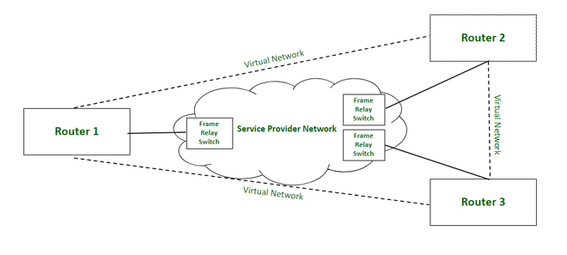

Slide 9
Forward Explicit Congestion Network (FECN)
FECN is a part of the frame header that is used to notify the destination about the congestion in the network. Whenever a frame experiences congestion while transmission, the frame relay switch of the destination network sets the FECN bit of the packet that allows the destination to identify that packet has experienced some congestion while transmission.

Slide 10
Backward Explicit Congestion Network (BECN)
BECN is a part of the frame header that is used to notify the source about the congestion in the network. Whenever a frame experiences congestion while transmission, the destination sends a frame back to the source with a set BECN bit that allows the source to identify that packet that was transmitted had experienced some congestion while reaching out to the destination. Once, source identifies congestion in the virtual circuit, it slows down to transmission to avoid network overhead.

Slide 11
Discard Eligibility (DE)
DE is a part of the frame header that is used to indicate the priority for discarding the packets. If the source is generating a huge amount of traffic on the certain virtual network then it can set DE bits of less significant packets to indicate the high priority for discarding the packets in case of network overhead. Packets with set DE bits are discarded before the packets with unset DE bits in case of congestion within a network.

Slide 12
CONGESTION CONTROL IN TCP:
TCP uses a congestion window and a congestion policy that avoid
congestion.
Congestion policy in TCP :
Slow Start Phase:
Starts slowly increment is exponential to threshold
Congestion Avoidance Phase:
After reaching the threshold increment is by 1
Congestion Detection Phase:
Sender goes back to Slow start phase or Congestion avoidance phase.

Slide 13
Slow Start Phase : exponential increment
In this phase after every RTT the congestion window size increments exponentially.
Initially
cwnd = 1 After 1 RTT, cwnd = 2^(1) = 2
2 RTT, cwnd = 2^(2) = 4
3 RTT, cwnd = 2^(3) = 8

Slide 14
Congestion Avoidance Phase : additive increment
This phase starts after the threshold value also denoted as ssthresh. The size of cwnd(congestion window) increases additive. After each
RTT cwnd = cwnd + 1.
Initially cwnd = I
After 1 RTT, cwnd = i+1
2 RTT, cwnd = i+2
3 RTT, cwnd = i+3

Slide 15
Congestion Detection Phase : multiplicative decrement
If congestion occurs, the congestion window size is decreased. The only way a sender can guess that congestion has occurred is the need to retransmit a segment. Retransmission is needed to recover a missing packet that is assumed to have been dropped by a router due to congestion. Retransmission can occur in one of two cases: when the RTO timer times out or when three duplicate ACKs are received

Slide 16
Case 1 : Retransmission due to Timeout – In this case congestion possibility is high.(a) ssthresh is reduced to half of the current window size.
(b) set cwnd = 1
(c) start with slow start phase again.

Slide 17
Case 2 : Retransmission due to 3 Acknowledgement Duplicates – In this case congestion possibility is less.(a) ssthresh value reduces to half of the current window size.
(b) set cwnd= ssthresh
(c) start with congestion avoidance phase

Slide 18
Source based congestion Avoidance :
It is a strategy for detecting the incipient stages of congestion before losses occur from the end hosts.
First algorithm exploits one observation The congestion window normally increases as in TCP But every 2 round trip delays algorithm checks to see if
the current RTT is greater than the average of the minimum & maximum RTTs.
If it then the algorithm decreases The congestion window by one eight.
A second algorithm does in the same way.
The window is adjusted once every 2 round trip delays based on the product.
(current window – old window)
x (current RTT-old RTT)
If the result is positive, the source decreases the window size by one eighth.

Slide 19
If the result is negative or 0, the source increases the window by one maximum packet size.
In the third algorithm, every RTT, it increases the window size by one packet and compares the throughput achieved to the throughput when the window was one packet smaller.
A fourth mechanism looks at changes in the throughput rate or more specifically changes in the sending rate.
DEC bit Scheme(Decreasing Bit-rate):
It was developed for use on the digital Network Architecture.
This mechanism is applied to TCP and IP
The idea is to more evenly split the responsibility for congestion control between the routers and the end nodes.
Every router monitors the load it is experiencing and also notices the end nodes when congestion is about to occur.
This notification is implemented by setting a binary congestion bit in the packets in the router.

Slide 20
The destination host then copies this congestion bit into the Ack it sends back to the source. Finally the source adjusts it's sending rate so as to avoid congestion.
A single congestion bit is added to the packet header.
A router sets this bit in a packet if it's average Queue length is greater than or equal to at the time the packet arrives.
This average Queue length is measured over a time interval that spans the last busy +idle cycle, plus the current busy cycle.
The router calculates the area under the curve and divides this value by the time interval to compute the average Queue length.

Slide 21
QOS [Quality of Services]
Quality of Service (QOS) determines a network's capability to support predictable service over various technologies, containing frame relay, Asynchronous Transfer Mode (ATM), Ethernet, SONET IP-routed networks. The networks can use any or all of these frameworks.
The QOS also provides that while supporting priority for one or more flows does not create other flows fail. A flow can be a combination of source and destination addresses, source and destination socket numbers, session identifier, or packet from a specific application or an incoming interface

Slide 22
QOS [Quality of Services]
The QOS is primarily used to control resources like bandwidth, equipment, wide-area facilities etc. It can get more efficient use of network resources, provide tailored services, provide coexistence of mission-critical applications, etc

Slide 23
QOS [Quality of Services]
Congestion Management
The bursty feature of data traffic sometimes bounds to increase traffic more than a connection speed. QoS allows a router to put packets into different queues. Service specific queues more often depend on priority than buffer traffic in an individual queue and let the first packet by the first packet out.

Slide 24
QOS [Quality of Services]
Queue Management
The queues in a buffer can fill and overflow. A packet would be dropped if a queue is complete, and the router cannot prevent it from being dropped if it is a high priority packet. This is referred to as tail drop
Link Efficiency
The low-speed links are bottlenecks for lower packets. The serialization delay caused by the high packets forces the lower packets to wait longer. The serialization delay is the time created to put a packet on the connection.

Slide 25
QOS [Quality of Services]
Elimination of overhead bits
It can also increase efficiency by removing too many overhead bits
Traffic shaping and policing
Shaping can prevent the overflow problem in buffers by limiting the full bandwidth potential of the applications packets. Sometimes, many network topologies with a high bandwidth link connected with a low-bandwidth link in remote sites can overflow low bandwidth connections.
Therefore, shaping is used to provide the traffic flow from the high bandwidth link closer to the low bandwidth link to avoid the low bandwidth link's overflow. Policing can discard the traffic that exceeds the configured rate, but it is buffered in the case of shaping

Slide 26
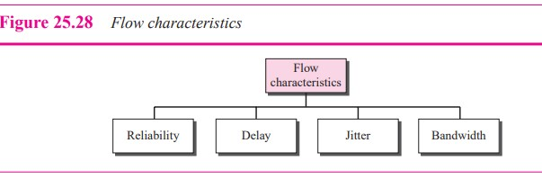
Flow Characteristics:
Traditionally, four types of characteristics are attributed to a flow:
Reliability, delay, jitter, and bandwidth.

Slide 27
Reliability:
Reliability is an important characteristic of flow.
Lack of reliability means losing a packet or acknowledgement which then requires retransmission.
However, the sensitivity of application programs to reliability is not the same. For example, it is more important that electronic mail, file transfer, and internet access have reliable transmissions than audio conferencing or telephony.
Delay:
Source to destination delay is another flow characteristic.
Applications can tolerate delay in different degrees.
In this case, telephony, audio conferencing, video conferencing and remote log in need minimum delay while delay in file transfer or e-mail is less important.

Slide 28
Jitter:
Jitter is defined as the variation in delay for packets belonging to the same flow.
High Jitter means the difference between delays is large and low jitter means the variation is small.
For example, if four packets depart at times 0, 1,2,3 and arrive at 20, 21,22, 23, all have same delay, 20 units of time. On the other hand, if the above four packets arrive at 21,23,21, and 28 they will have different delays of21, 22, 19 and 24.
Bandwidth:
Different applications need different bandwidths.
In video conferencing we need to send million of bits per second to refresh a colour screen while the total number of bits in an email may not reach even a million.

Slide 29
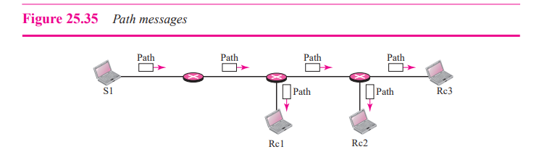
RSVP(Resource Reservation Protocol) Messages:
RSVP has several types of messages we discuss only two them they are:
1.Path Messages 2.Resv Messages
1.Path Messages: A Path message travels from the sender and reaches all receivers in the multicast path. On the way, a Path message stores the necessary information for the receivers. A Path message is sent in a multicast environment.

Slide 30
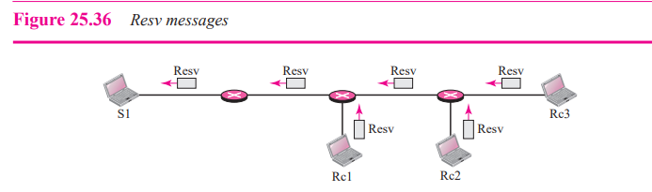
2.Resv Messages:
After a receiver has received a Path message, it sends a Resv message. The Resv message travels toward the sender (upstream) and makes a resource reservation on the routers that support RSVP. If a router does not support RSVP on the path, it routes the packet based on the best-effort delivery methods.

Slide 31
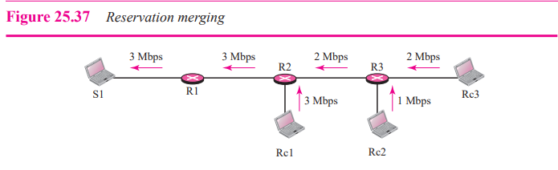
Reservation Merging:
In RSVP, the resources are not reserved for each receiver in a flow; the reservation is merged. In Figure 25.37, Rc3 requests a 2-Mbps bandwidth while Rc2 requests a 1-Mbps bandwidth. Router R3, which needs to make a bandwidth reservation, merges the two requests. The reservation is made for 2 Mbps, the larger of the two, because a 2-Mbps input reservation can handle both requests. The same situation is true for R2. The reader may ask why Rc2 and Rc3, both belonging to one single flow, request different amounts of bandwidth. The answer is that, in a multimedia environment, different receivers may handle different grades of quality. For example, Rc2 may be able to receive video only at 1 Mbps (lower quality), while Rc3 may be able to receive video at 2 Mbps (higher quality).

Slide 32
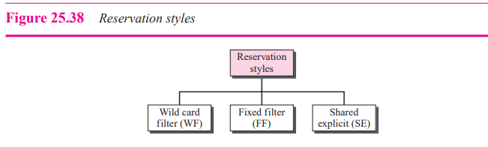
Reservation Styles:
When there is more than one flow, the router needs to make a reservation to accommodate all of them. RSVP defines three types of reservation styles.
1.Wild Card Filter Style:
In this style, the router creates a single reservation for all senders. The reservation is based on the largest request. This type of style is used when the flows from different senders do not occur at the same time.

Slide 33
2.Fixed Filter Style:
In this style, the router creates a distinct reservation for each flow. This means that if there are n flows, n different reservations are made. This type of style is used when there is a high probability that flows from different senders will occur at the same time.
3.Shared Explicit Style:
In this style, the router creates a single reservation that can be shared by a set of flows.
Problems with Integrated Services:
They are 2 types 1. Scalability 2.Service-Type Limitation
1.Scalability:
The Integrated Services model requires that each router keep information for each flow. As the Internet is growing every day, this is a serious problem.
2.Service-Type Limitation:
The Integrated Services model provides only two types of services, guaranteed and control-load. Those opposing this model argue that applications may need more than these two types of services

Slide 34
Differentiated Services:
Differentiated Services is a class-based QoS model designed for IP.
Differentiated Services (DS or Diffserv) was introduced by the IETF (Internet Engineering Task Force) to handle the shortcomings of Integrated Services. Two fundamental changes were made:
The main processing was moved from the core of the network to the edge of the network. This solves the scalability problem. The routers do not have to store information about flows. The applications, or hosts, define the type of service they need each time they send a packet.
2. The per-flow service is changed to per-class service. The router routes the packet based on the class of service defined in the packet, not the flow. This solves the service-type limitation problem. We can define different types of classes based on the needs of applications.

Slide 35
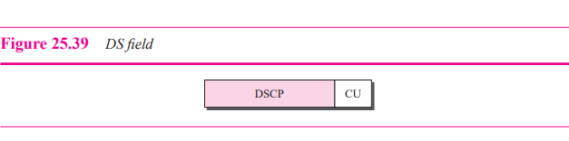
DS Field:
In Diffserv, each packet contains a field called the DS field. The value of this field is set at the boundary of the network by the host or the first router designated as the boundary router. IETF proposes to replace the existing TOS (type of service) field in IPv4 or the class field in IPv6 by the DS field.
The DS field contains two subfields: DSCP and CU. The DSCP (Differentiated Services Code Point) is a 6-bit subfield that defines the per-hop behavior (PHB). The 2-bit CU (currently unused) subfield is not currently used. The Diffserv capable node (router) uses the DSCP 6 bits as an index to a table defining the packet-handling mechanism for the current packet being processed.

Slide 36
Per-Hop Behavior:
The Diffserv model defines per-hop behaviors (PHBs) for each node that receives a packet.
Traffic Conditioner :
To implement Diffserv, the DS node uses traffic conditioners such as meters, markers, shapers, and droppers.
Meters:
The meter checks to see if the incoming flow matches the negotiated traffic profile. The meter also sends this result to other components. The meter can use several tools such as a token bucket to check the profile.
Marker:
A marker can remark a packet that is using best-effort delivery (DSCP: 000000) or down-mark a packet based on information received from the meter. Down marking (lowering the class of the flow) occurs if the flow does not match the profile. A marker does not up-mark a packet (promote the class).

Slide 37
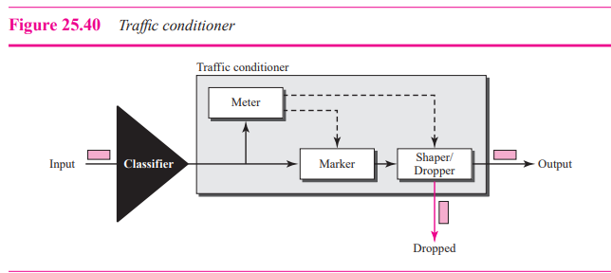
Shaper:
A shaper uses the information received from the meter to reshape the traffic if it is not compliant with the negotiated profile.
Dropper:
A dropper, which works as a shaper with no buffer, discards packets if the flow severely violates the negotiated profile.

Slide 38
2. Traffic Shaping:
Traffic shaping is a mechanism to control the amount and the rate of the traffic sent to the network.
Two techniques can shape traffic: i. Leaky bucket ii. Token bucket. i. Leaky Bucket:
If a bucket has a small hole at the bottom, the water leaks from the bucket at a constant rate as long as there is water in the bucket. The rate at which the water leaks does not depend on the rate at which the water is input to the bucket unless the bucket is empty. The input rate can vary, but the output rate remains constant. Similarly, in networking, a technique called leaky bucket can smooth out bursty traffic. Bursty chunks are stored in the bucket and sent out at an average rate. Figure 25.32 shows a leaky bucket and its effects.
In the figure, we assume that the network has committed a bandwidth of 3 Mbps for a host.
The use of the leaky bucket shapes the input traffic to make it conform to this commitment.
In Figure 25.32 the host sends a burst of data at a rate of 12 Mbps for 2 s, for a total of 24 Mbits of data. The host is silent for 5 s and then sends data at a rate of 2 Mbps for 3 s, for a total of 6 Mbits of data. In all, the host has sent 30 Mbits of data in 10 s. The leaky bucket smooths the traffic by sending out data at a rate of 3 Mbps during the same 10 s. Without the leaky bucket, the beginning burst may have hurt the network by consuming more bandwidth than is set aside for this host. We can also see that the leaky bucket may prevent congestion.

Slide 39
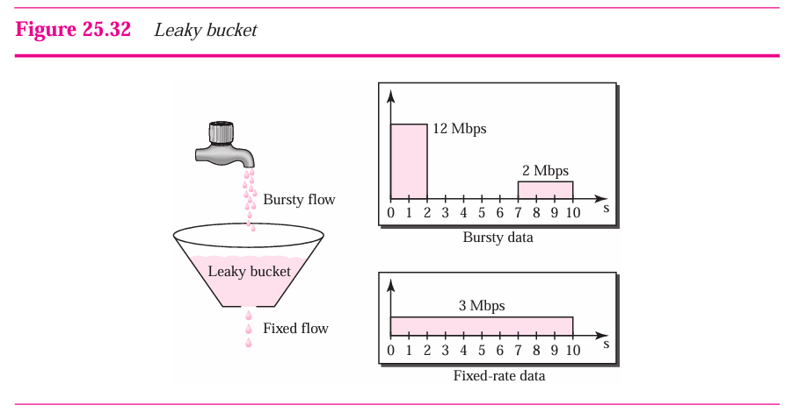

Slide 40
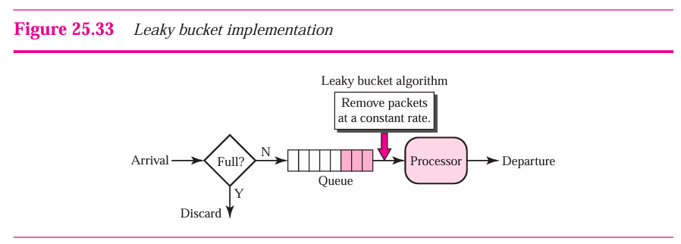
A simple leaky bucket implementation is shown in Figure 25.33. A FIFO queue holds the packets. If the traffic consists of fixed-size packets (e.g., cells in ATM networks), the process removes a fixed number of packets from the queue at each tick of the clock. If the traffic consists of variable-length packets, the fixed output rate must be based on the number of bytes or bits.
Important Point: A leaky bucket algorithm shapes bursty traffic into fixed-rate traffic by averaging the data rate. It may drop the packets if the bucket is full.

Slide 41
ii. Token Bucket:
The leaky bucket is very restrictive. It does not credit an idle host. For example, if a host is not sending for a while, its bucket becomes empty. Now if the host has bursty data, the leaky bucket allows only an average rate. The time when the host was idle is not taken into account. On the other hand, the token bucket algorithm allows idle hosts to accumulate credit for the future in the form of tokens. For each tick of the clock, the system sends n tokens to the bucket. The system removes one token for every cell (or byte) of data sent. For example, if n is 100 and the host is idle for 100 ticks, the bucket collects 10,000 tokens. Now the host can consume all these tokens in one tick with 10,000 cells, or the host takes 1,000 ticks with 10 cells per tick. In other words, the host can send bursty data as long as the bucket is not empty. Figure 25.34 shows the idea.
The token bucket can easily be implemented with a counter. The token is initialized to zero. Each time a token is added, the counter is incremented by 1. Each time a unit of data is sent, the counter is decremented by 1. When the counter is zero, the host cannot send data.
Important Point: The token bucket allows bursty traffic at a regulated maximum rate.

Slide 42
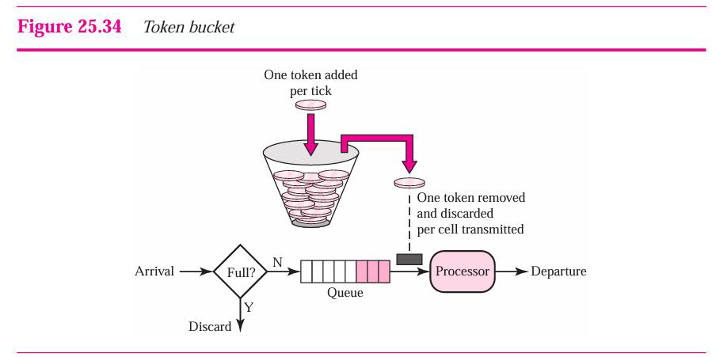

Slide 43
2. Resource Reservation:
A flow of data needs resources such as a buffer, bandwidth, CPU time, and so on. The quality of service is improved if these resources are reserved beforehand.
3. Admission Control:
Admission control refers to the mechanism used by a router, or a switch, to accept or reject a flow based on predefined parameters called flow specifications. Before a router accepts a flow for processing, it checks the flow specifications to see if its capacity (in terms of bandwidth, buffer size, CPU speed, etc.)
Two models have been designed to provide quality of service in the Internet:
1. Integrated Services 2. Differentiated Services
1. Integrated Services:
Integrated Services, sometimes called IntServ, is a flow-based QoS model, which means that a user needs to create a flow, a kind of virtual circuit, from the source to the destination and inform all routers of the resource requirement. i. Signaling:
IP is a connectionless, datagram, packet-switching protocol. How can we implement a flow-based model over a connectionless protocol. The solution is a signaling protocol to run over IP that provides the signaling mechanism for making a reservation. This protocol is called Resource Reservation Protocol (RSVP).

Slide 44
ii. Flow Specification:
When a source makes a reservation, it needs to define a flow specification. A flow specification has two parts:
Rspec (resource specification) and Tspec (traffic specification). Rspec defines the resource that the flow needs to reserve
(buffer, bandwidth, etc.). Tspec defines the traffic characterization of the flow. iii. Admission:
After a router receives the flow specification from an application, it decides to admit or deny the service. The decision is based on the previous commitments of the router and the current availability of the resource. iv. Service Classes:
Two classes of services have been defined for Integrated Services: guaranteed service and controlled-load service. i. Guaranteed Service Class:
This type of service is designed for real-time traffic that needs a guaranteed minimum end-to-end delay. The end-to-end delay is the sum of the delays in the routers, the propagation delay in the media, and the setup mechanism.
Only the first, the sum of the delays in the routers, can be guaranteed by the router. This type of service guarantees that the packets will arrive within a certain delivery time and are not discarded if flow traffic stays within the boundary of Tspec.
We can say that guaranteed services are quantitative services, in which the amount of end-to-end delay and the data rate must be defined by the application. ii. Controlled-Load Service Class:
This type of service is designed for applications that can accept some delays, but are sensitive to an overloaded network and to the danger of losing packets. Good examples of these types of applications are file transfer, e-mail, and Internet access. The controlled load service is a qualitative type of service in that the application requests the possibility of low-loss or no-loss packets.

Slide 45
v. Resource Reservation Protocol(RSVP):
In the Integrated Services model, an application program needs resource reservation. at the IP level, we need to create a flow, a kind of virtual-circuit network, out of the IP, which was originally designed as a datagram packet-switched network. A virtual-circuit network needs a signaling system to set up the virtual circuit before data traffic can start. The Resource Reservation Protocol (RSVP) is a signaling protocol to help IP create a flow and consequently make a resource reservation.
RSVP has several types of messages we discuss only two them they are:
1.Path Messages 2.Resv Messages
1.Path Messages: A Path message travels from the sender and reaches all receivers in the multicast path. On the way, a Path message stores the necessary information for the receivers. A Path message is sent in a multicast environment.

Slide 46
2.Resv Messages:
After a receiver has received a Path message, it sends a Resv message. The Resv message travels toward the sender (upstream) and makes a resource reservation on the routers that support RSVP. If a router does not support RSVP on the path, it routes the packet based on the best-effort delivery methods.

Slide 47
Reservation Merging:
In RSVP, the resources are not reserved for each receiver in a flow; the reservation is merged. In Figure 25.37, Rc3 requests a 2-Mbps bandwidth while Rc2 requests a 1-Mbps bandwidth. Router R3, which needs to make a bandwidth reservation, merges the two requests. The reservation is made for 2 Mbps, the larger of the two, because a 2-Mbps input reservation can handle both requests. The same situation is true for R2. The reader may ask why Rc2 and Rc3, both belonging to one single flow, request different amounts of bandwidth. The answer is that, in a multimedia environment, different receivers may handle different grades of quality. For example, Rc2 may be able to receive video only at 1 Mbps (lower quality), while Rc3 may be able to receive video at 2 Mbps (higher quality).

Slide 48
Reservation Styles:
When there is more than one flow, the router needs to make a reservation to accommodate all of them. RSVP defines three types of reservation styles.

Slide 49
1.Wild Card Filter Style:
In this style, the router creates a single reservation for all senders. The reservation is based on the largest request. This type of style is used when the flows from different senders do not occur at the same time.
2.Fixed Filter Style:
In this style, the router creates a distinct reservation for each flow. This means that if there are n flows, n different reservations are made. This type of style is used when there is a high probability that flows from different senders will occur at the same time.
3.Shared Explicit Style:
In this style, the router creates a single reservation that can be shared by a set of flows.
Problems with Integrated Services:
They are 2 types 1. Scalability 2.Service-Type Limitation
1.Scalability:
The Integrated Services model requires that each router keep information for each flow. As the Internet is growing every day, this is a serious problem.
2.Service-Type Limitation:
The Integrated Services model provides only two types of services, guaranteed and control-load. Those opposing this model argue that applications may need more than these two types of services

